Slide 1
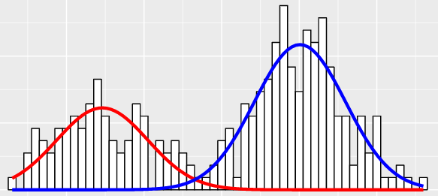
Find The Optimal Threshold Value
Given:
Two separate gaussian models
with unknown means and standard deviations
Required:
Multiple ways to calculate the optimal threshold value to separate between the distributions
Notes:
You are given a set of values that are sampled from 2 separate gaussian models with unknown means and standard deviations.
You are required to provide the optimal threshold value to separate between the distributions.
Please think of multiple ways to solve this problem and be prepared to compare between solutions.

Slide 2
Maximum Entropy Threshold
Maximum Entropy algorithm has the same purpose as Otsu Thresholding technique. Here, rather than maximizing the inter-class variance (equivalently, minimizing the within-class variance), the inter-class entropy is maximized.

Slide 3
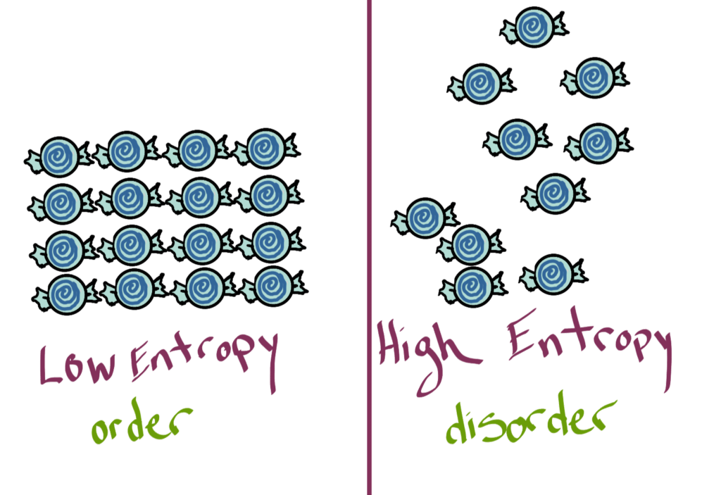
What’s Entropy?
Notes:
Entropy is a scientific concept, as well as a measurable physical property that is most commonly associated with a state of disorder, randomness, or uncertainty.

Slide 4
Finding optimal threshold using the maximum entropy method
Motivation:
More uncertainty -> higher entropy value
Notes:
We need to know which indexes belong to the foreground and which ones belong to the background. The more we are close to the peaks, we are more certain about being in the background/ foreground. The most uncertain indexes are in places where the two distributions meet and as we know from the definition of entropy, in these indexes we have higher entropy values. The optimal threshold is the point where we are the most uncertain and, in that point, the entropy will have its maximum value and that’s why our problem becomes finding the maximum entropy

Slide 5

Entropy Mathematic Definition
Let X be a random variable (let’s look at discrete variable), X$∈S$
X$\sim P$
The entropy of X is H(X)=$−\sum_{X∈S}{p\left(x\right)∗ \log_{2}{(p\left(x\right))}⁡}$
Remark: H(X)$≥0$
Notes:
הסתברות בין 0 לאחד, log בתחום הזה נותן ערכים שליליים, לכן האנטרופיה תמיד חיובית

Slide 6
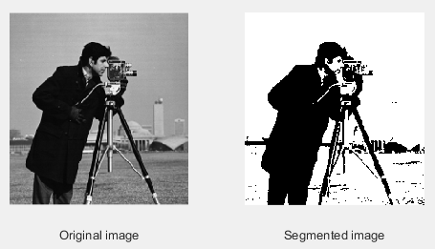
Finding optimal threshold using the maximum entropy method
Solution: Threshold is 98

Slide 7
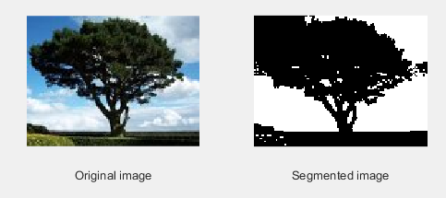
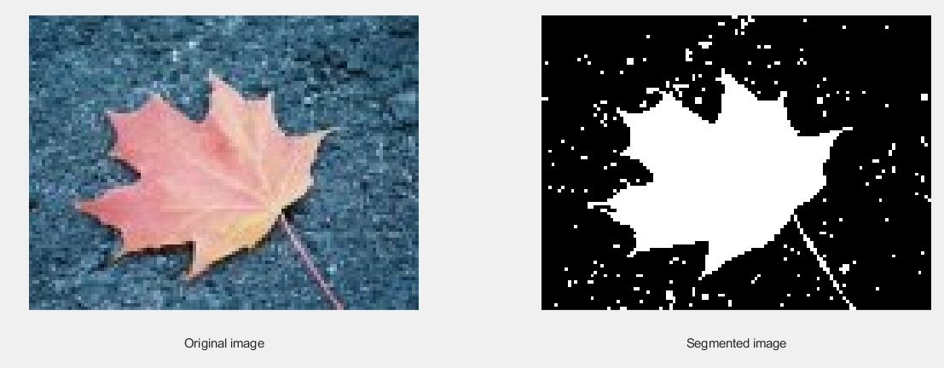
More thresholding examples using max-entropy’s method
Threshold is 146, ground truth is 115
Error = 26.95%
Threshold is 135, ground truth is 154
Error = 12.33%

Slide 8
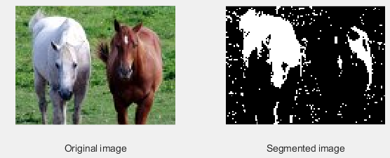
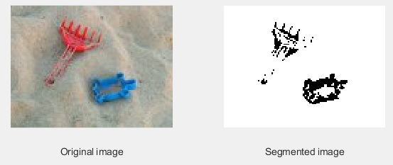
More thresholding examples using max-entropy’s method
Threshold is 146, ground truth is 84
Error = 73%
Threshold is 104, ground truth is 91
Error = 14.28%

Slide 9
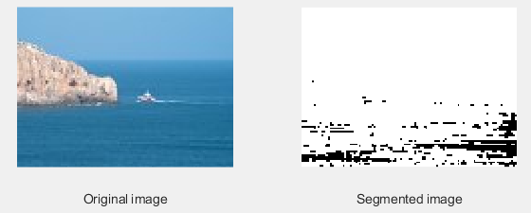
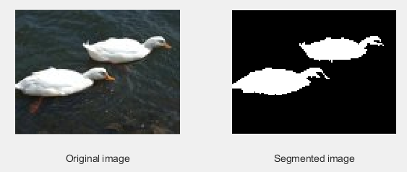
More thresholding examples using max-entropy’s method
Threshold is 91, ground truth is 128
Error = 28.90%
Threshold is 132, ground truth is 139
Error = 5.03%

Slide 10
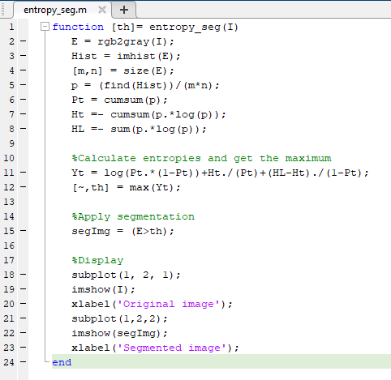
Algorithm implementation:

Slide 11
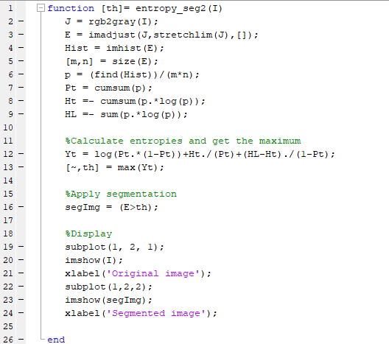
Algorithm implementation
Enhancement

Slide 12

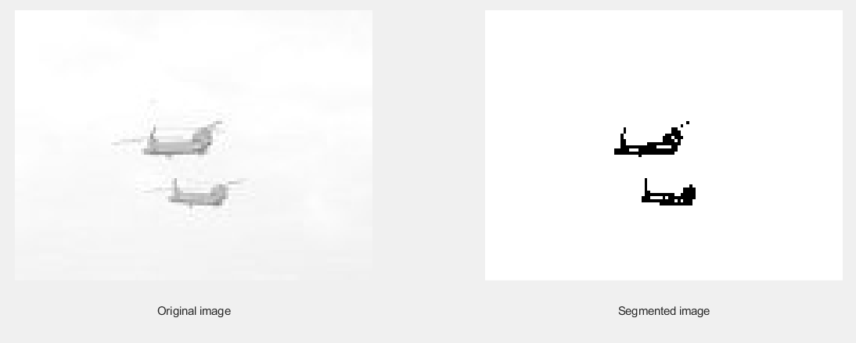
Before and After Enhancing Contrast
Notes:
הגברת קונטרסט ע"י הרחבת ההיסטוגרמה

Slide 13

Conclusions
Max entropy method works better when background and foreground are clearly distinguishable

Slide 14

Questions?

